Slide 2
Automation Outlook
NFEC
13.03.25

Slide 3
What is FANUC?
Who are Fanuc?

Slide 4
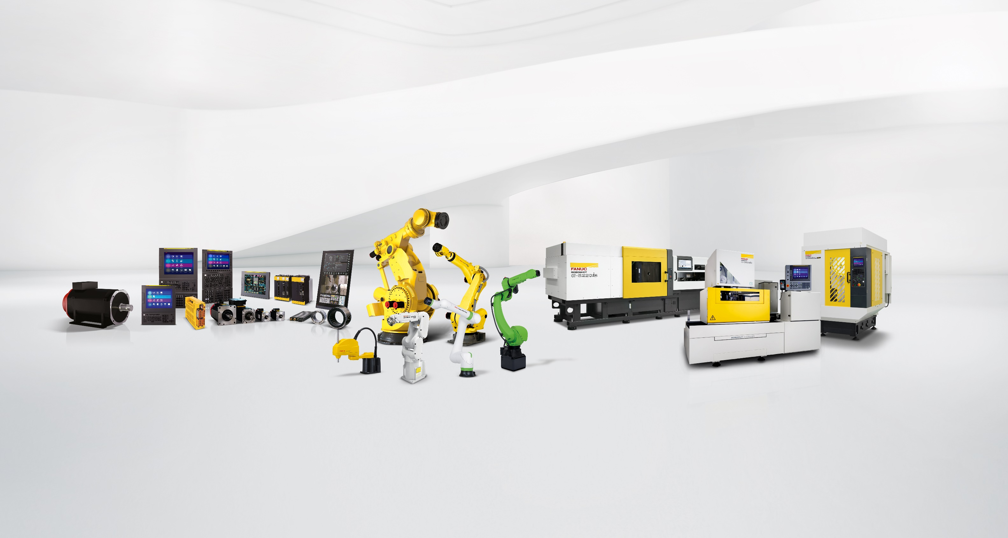
We come from a very special place – Facts
FANUC Products
CNC CONTROLS
SERVO MOTORS
SERVO AMPLIFIERS LASER INTERFACE
INDUSTRIAL ROBOTS
COBOTS
ACCESSORIES
SOFTWARE
WIRE-CUT ELECTRIC DISCHARGE MACHINES
VERTICAL MACHINING CENTRES
INJECTION MOULDING MACHINES
INDUSTRIAL IOT SOLUTIONS

Slide 5
What is FANUC?
What is Automation?

Slide 6
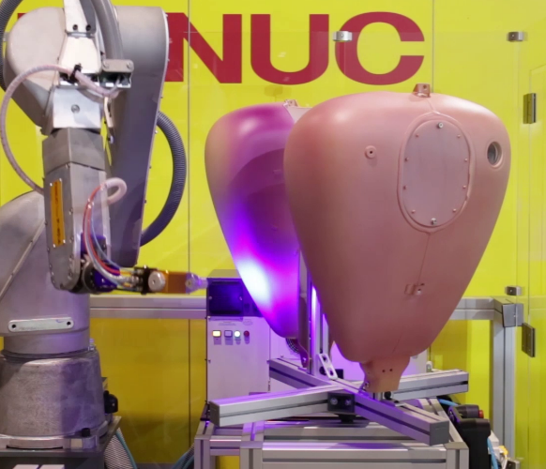
Paint
Loading & Unloading
Deburring
PalletiSing
Packing
Washing
Notes:
Also Alignment and Sealing

Slide 7
Spot welding
Arc Welding
Handling
Assembly
Notes:
Also Alignment and Sealing

Slide 8
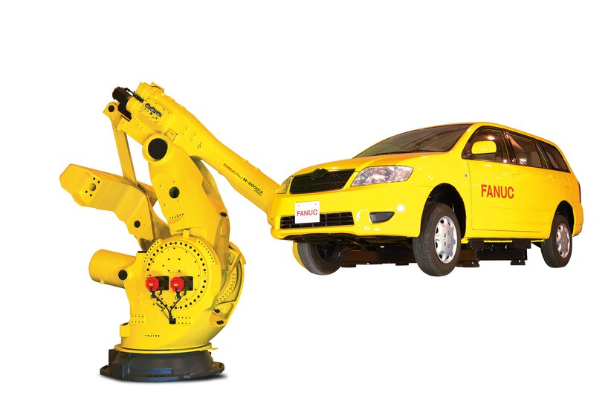
How much does a Robot cost?

Slide 9
What value can then be added to the robots?
Hardware
Controls
Vision Systems
Integration into existing lines
Robot programming
PLC programming
Careers

Slide 10
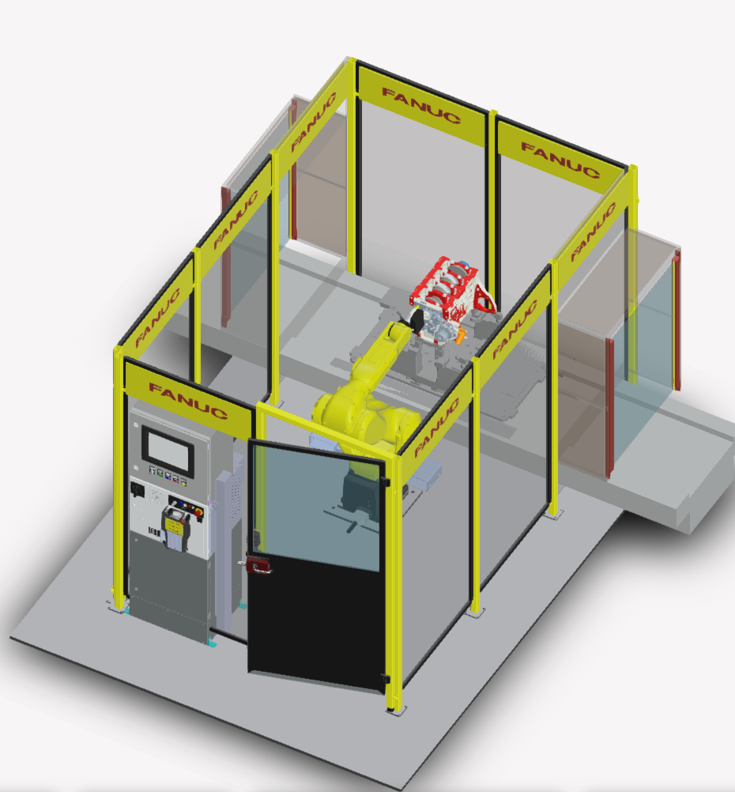
How much does a system cost?
£150,000

Slide 11
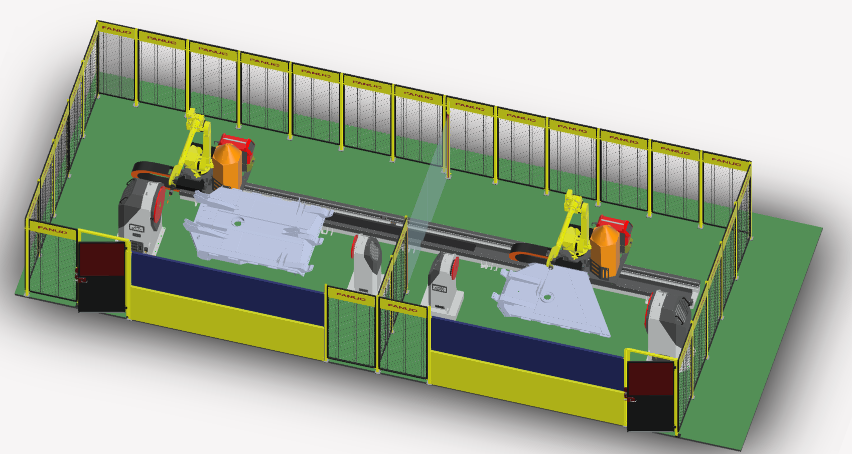
How much does a system cost?
£600,000

Slide 12
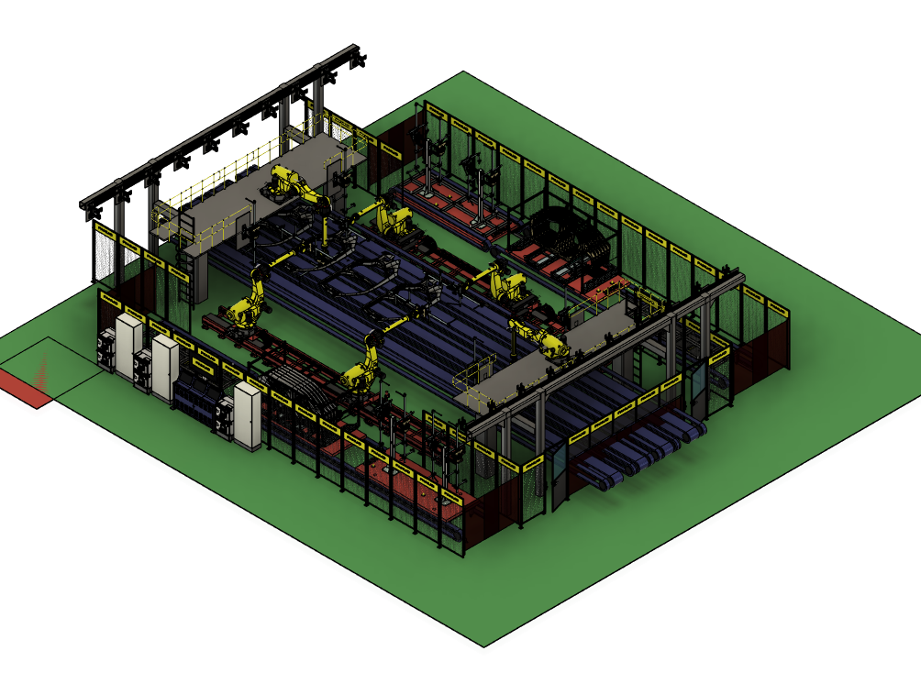
How much does a system cost?
£5,500,000

Slide 13
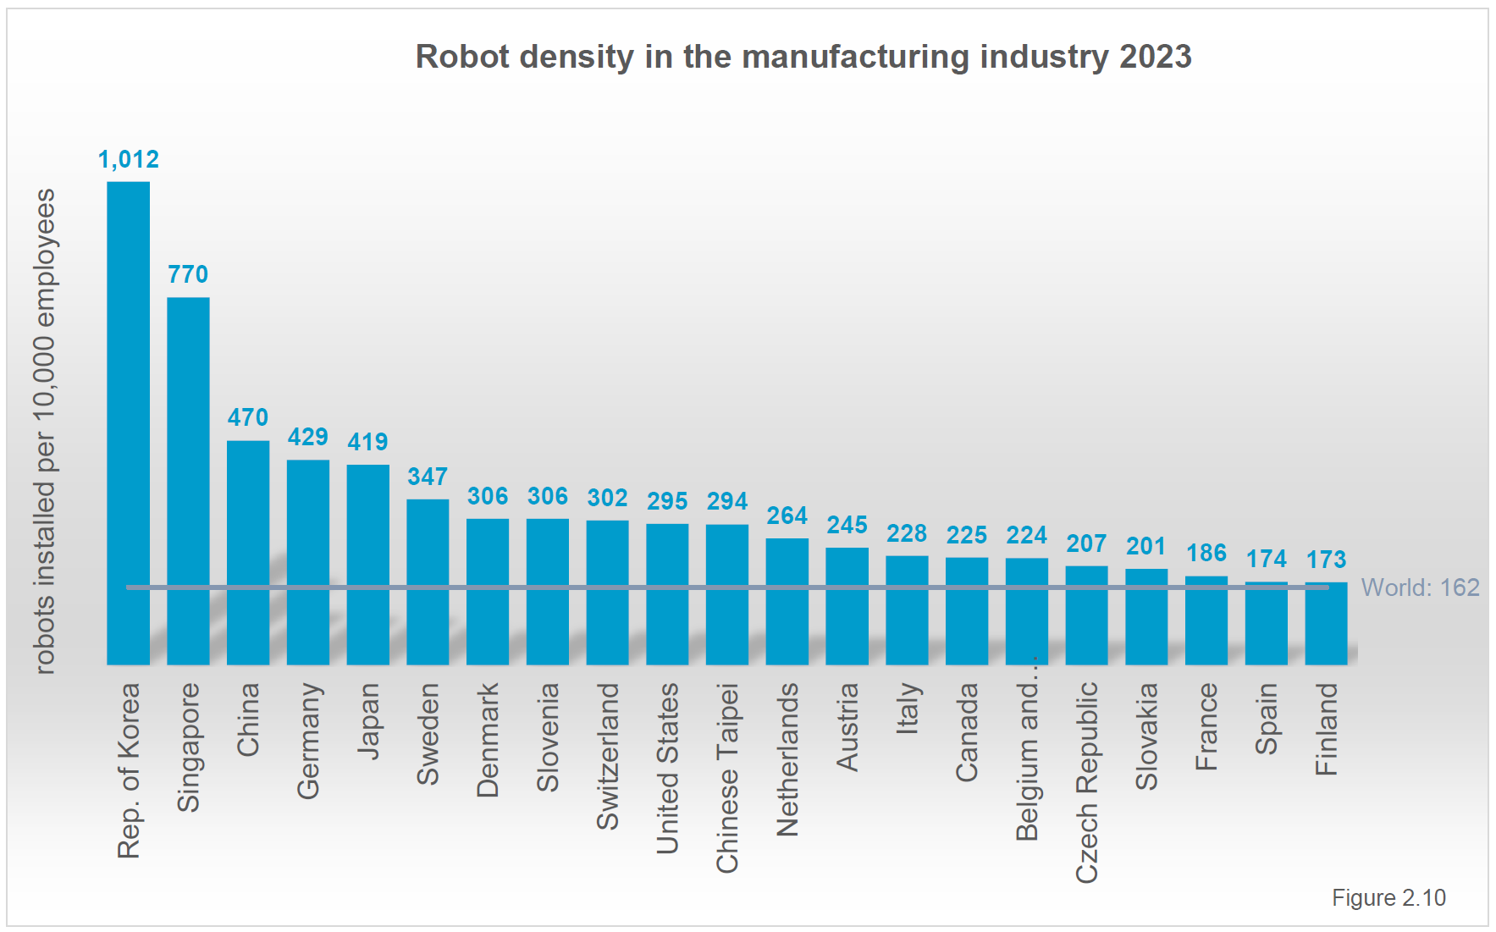
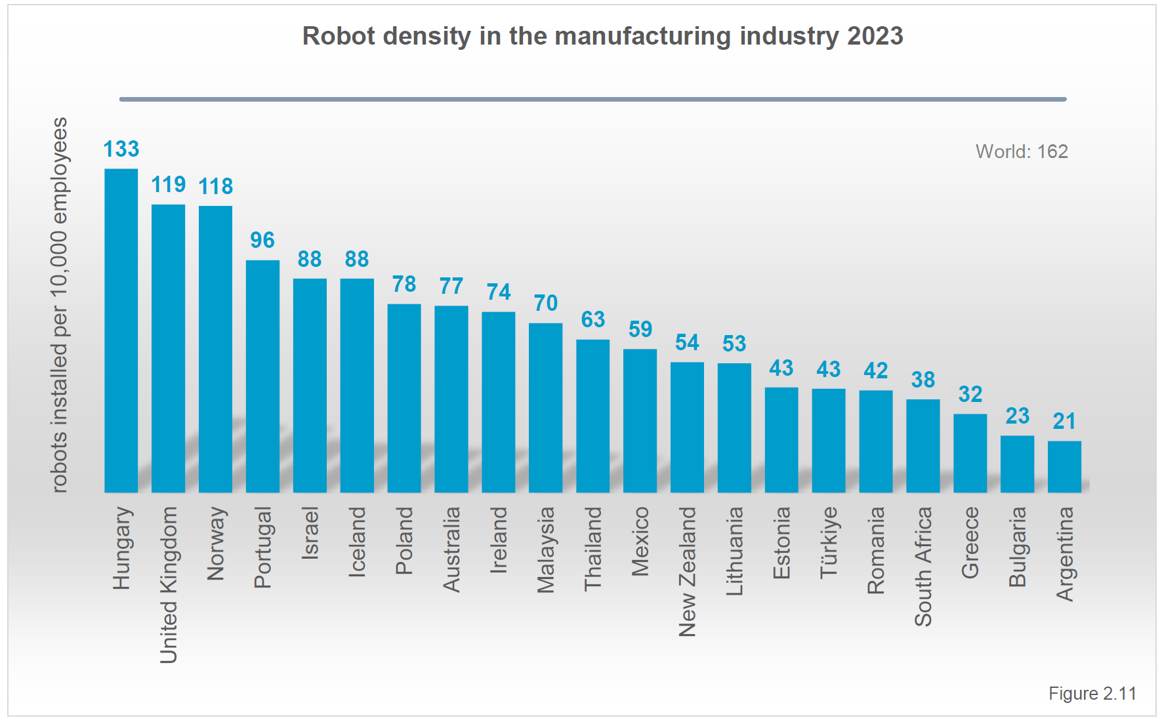
Current state of automation in the UK
(Density per 100,000 workers)

Slide 14
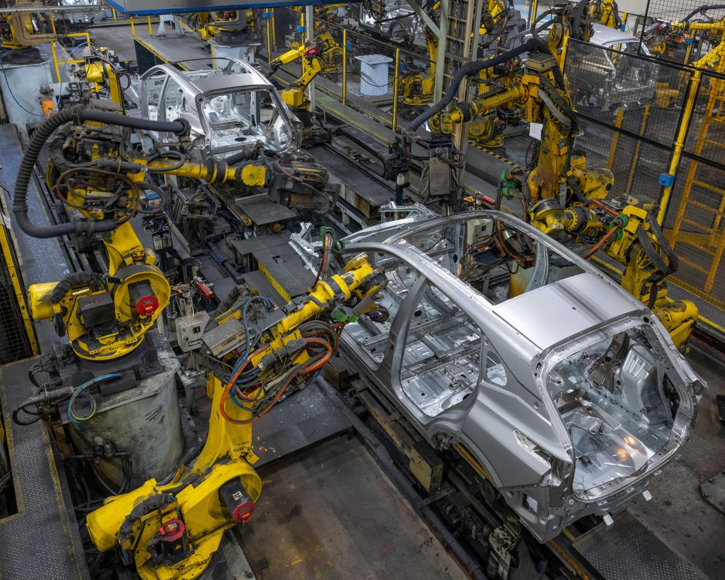
Automation Strengths in the UK
Automotive

Slide 15
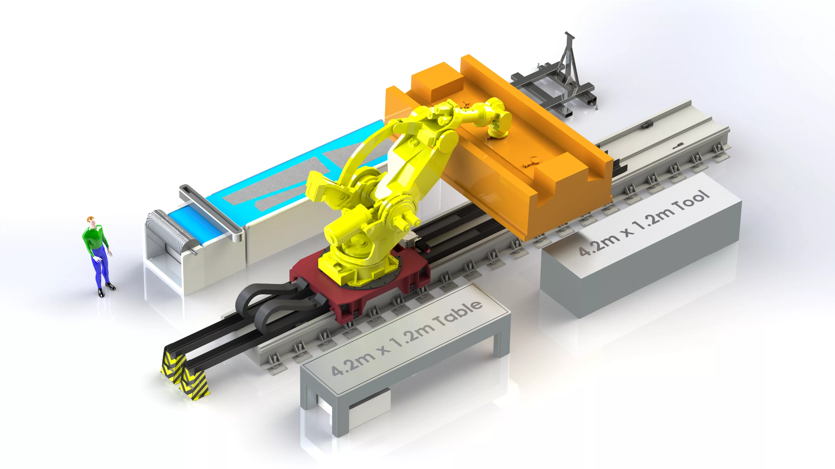
Automation Strengths in the UK
Research and Development

Slide 16
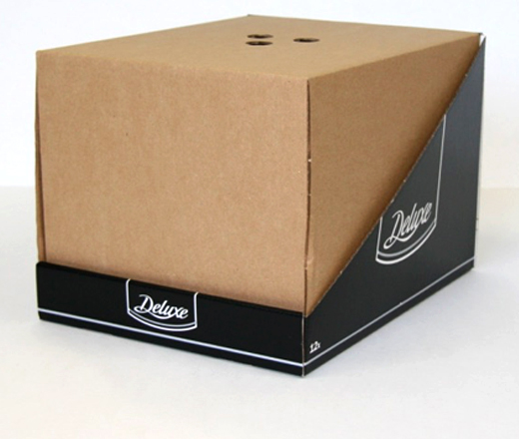
-Design for Manufacture
-Manufacturing facilities being built with automation in mind.
-Stronger manufacturing output
-Automation skilled workforce in mind
-Skills gap
UK’s opportunity with Automation

Slide 17
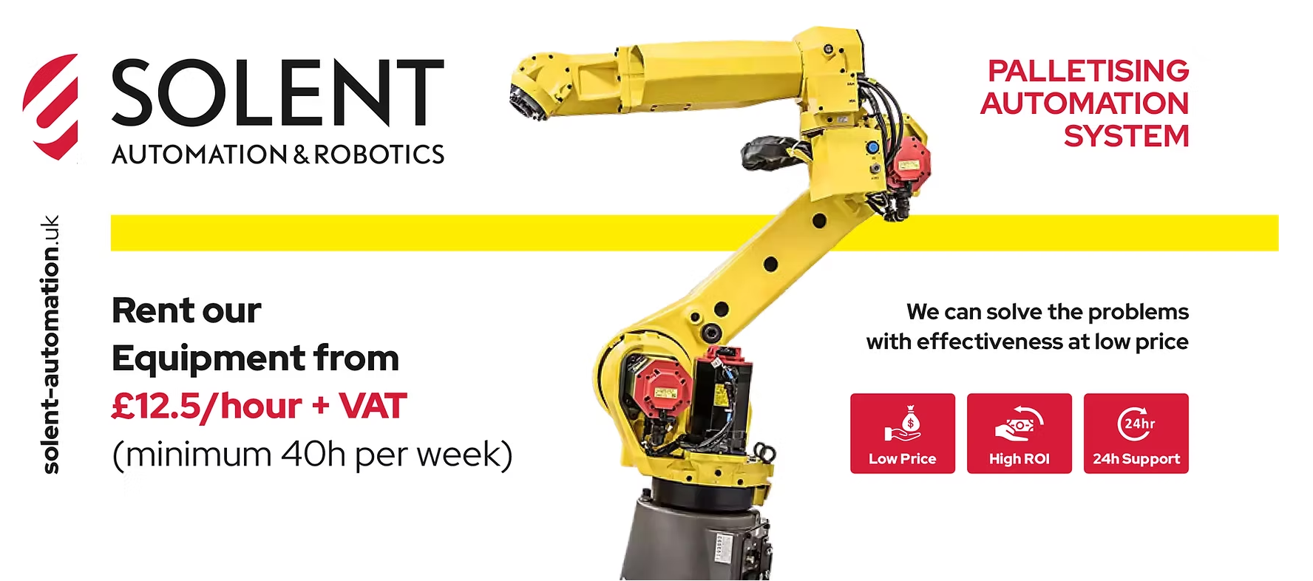
How are we changing the way we think?
Risk
What is Risk?
Different areas of Risk
Expenditure
Traditional CapEx V’s OpEx

Slide 18
What else can support adoption?
Total cost of ownership

Slide 19
What else can support adoption?
Suitable applications for Automation?
-How is Automation now being Sold?
-Risk
-ROI
-Safety
-Heavy OEM involvement
-RaaS

Slide 20
-Education across all levels of the business
-Degree level apprenticeships
-World Skills
-Institute of technology, catapult establishments and collaborations
-FANUC America CERT program
Education

Slide 21
Technical advancements in Robotics
How we used to do it…
How we do it now…

Slide 22
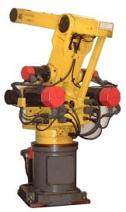
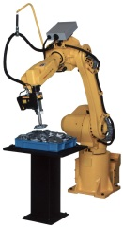
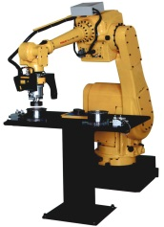
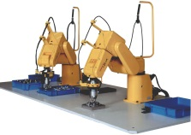
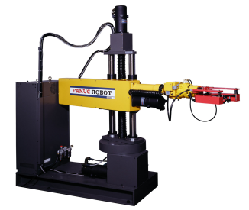
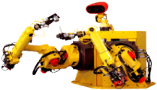
Installation of robots in FANUC factories
first articulated robot S-MODEL 1
Intelligent robot
I-21i series
1956
1977
1992
1974
1981
1999
NC and servo system
FANUC ROBOT-MODEL1
First prototype of intelligent robot (Dual arm, 7-axis)

Slide 23
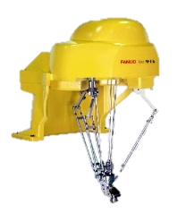
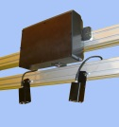
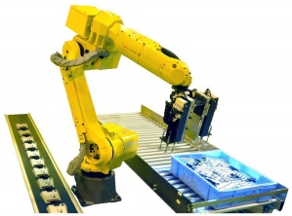
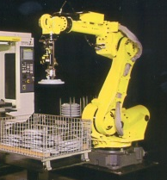
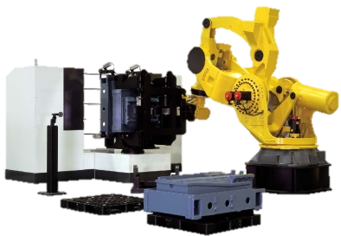
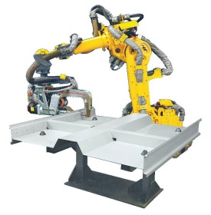
3rd generation unmanned machining system by intelligent robots (Robot Cell)
Genkotsu-robot M-1iA
3D area sensor
2000
2008
2011
2003
2009
2012
Multi purpose Intelligent robot R-2000i
Super heavy payload robot M-2000iA
Learning robot R-1000iA

Slide 24
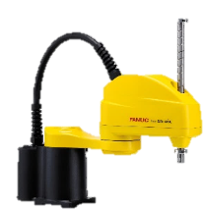
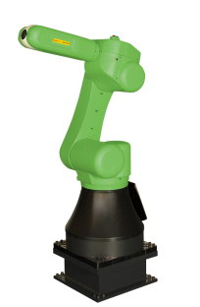
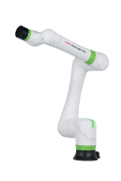
SCARA Robot
SR-3iA
2015
2020
The success story continues!
2017
Collaborative Robot CR Series
Collaborative Robot CRX Series

Slide 25
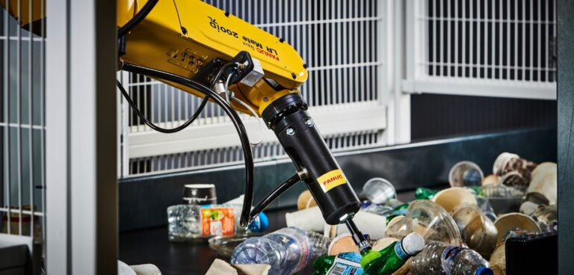
Technical advancements in Robotics
-Vision Systems
-Machine learning
-Part recognition

Slide 26
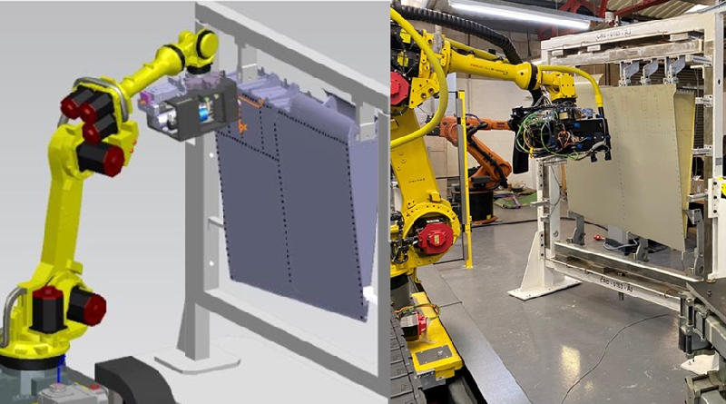
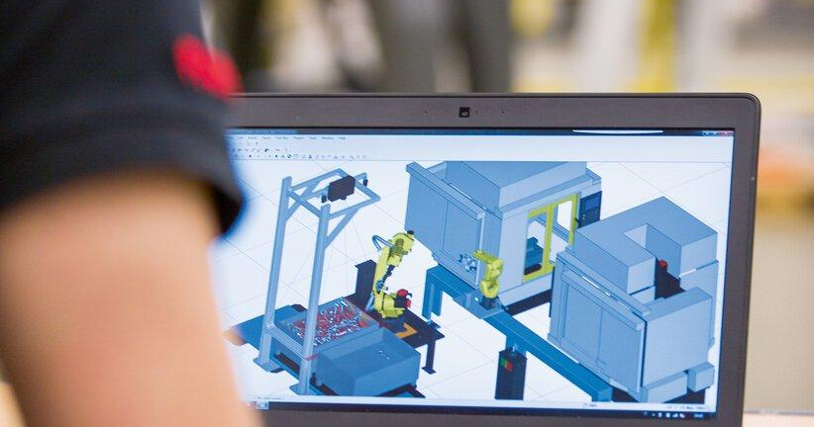
Technical advancements in Robotics
-Simulations
-Digital twin
-Derisking

Slide 27
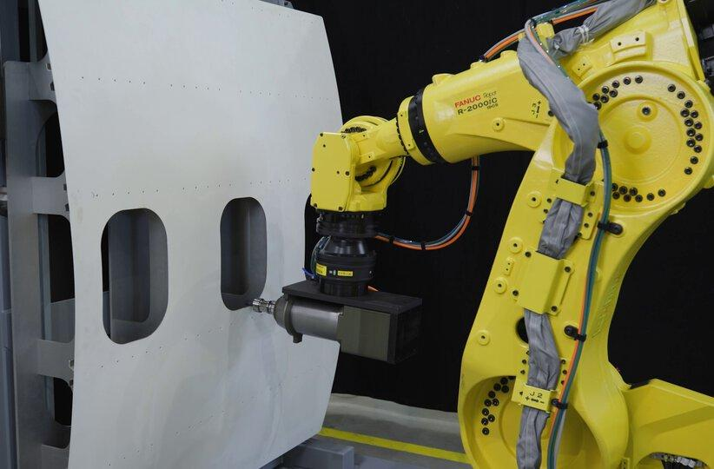
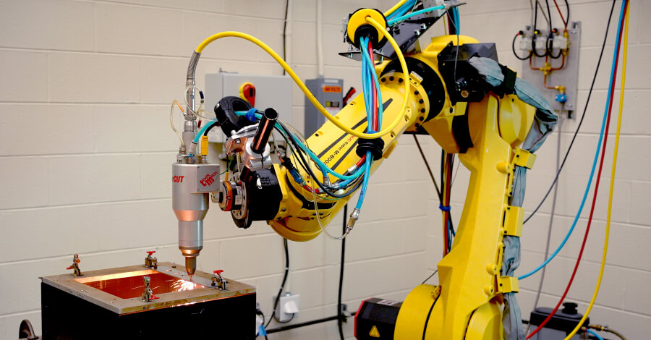
Technical advancements in Robotics
-High accuracy Robots
-Aerospace
-Drilling
-Cutting

Slide 28
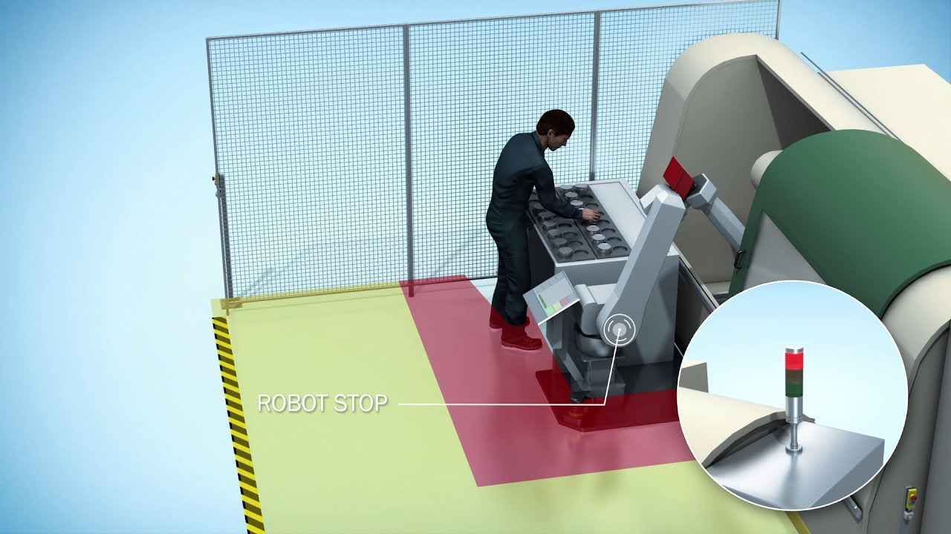
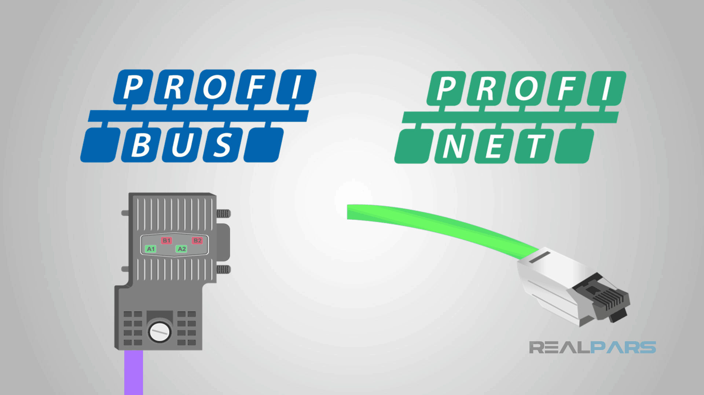
Technical advancements in Robotics
-Communications, safety and best practice

