Slide 1
DfE Level 3 Consultation Response
Post 16 Vocational Qualification Reform
Title Slide

Slide 2
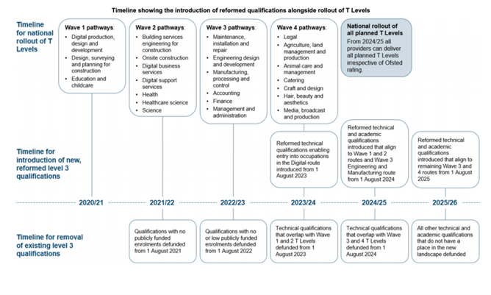
The timeline
Content Slide Text Only with Color Accents

Slide 3
The future landscape
Academic
AS/A Levels
Small qualifications alongside A Levels
Technical
T Levels
Specialist Qualifications
Apprenticeships
Apprenticeship Standards
Levels 2-7
Large alternatives to A Levels
Occupational-entry technical qualifications not served by T Levels
Mandatory/Optional Apprenticeship qualifications
Content Slide Text Only with Color Accents

Slide 4
What does this mean for Engineering Qualifications?
Removal of funding of Technical Qualifications – August 2024
Removal of funding of Applied General/Academic and non-Performance Table Qualifications – August 2025
New qualifications for Engineering and Manufacturing – Academic and Technical –August 2024
    New guidelines for Awarding Organisations available early 2022
    Academic qualifications approved by the DfE
    Technical qualifications approved by the IfATE
    Qualifications approved for funding by the ESFA
Content Slide Text Only with Color Accents

Slide 5
What does this mean for Engineering Qualifications?
The DfE, the Institute and the ESFA will publish a list of qualifications to be withdrawn each year from 2023 based on overlap with T Levels
Awarding Organisations have to resubmit all Engineering & Manufacturing qualifications for approval against the new criteria to retain availability and funding from August 2024
Pearson are currently looking at options for the Engineering and Manufacturing suite, identifying current gaps in provision and looking at the current requirements within the consultation response
Likely requirement to have new or existing qualifications approved by July 2023 to give providers time to prepare for new delivery
Only dual running will be of Applied General qualifications from 2024-2025 for one year only alongside approved revised Academic or Technical qualifications
Content Slide Text Only with Color Accents

Slide 6
What does this mean for Providers?
Can continue delivering existing qualifications until July 2024 (including non-performance table qualifications like AME)
Last date of registrations on existing Tech Level quals will be July 2024, last date for registrations on existing Applied General quals will be July 2025 (with no top up option to larger sizes)
Last date of registration for AME suite for standalone learners (16-19) is TBC but expected to be July 2025. Funding for mandated qualifications in Apprenticeships will continue
First teach for new qualifications approved under the technical and applied route from August 2024
T Levels and progression to HE, remember UCAS points does not guarantee entry acceptance
Content Slide Text Only with Color Accents

Slide 7

#ProtectStudentChoice​
Sign the petition to protect student choice from 2023​
The Government has recently completed a review and consultation that impacts Level 3 BTECs and other vocational qualifications in England starting in 2023. The main proposal is to introduce a binary system of T levels and A levels at Level 3, where most young people pursue one of these qualifications at the age of 16.​
The Sixth Form Colleges Association (SFCA) has launched a petition urging the government to reconsider restricting students' choice of qualifications at the age of 16. Sign the petition and #ProtectStudentChoice.​
>Sign the petition

Slide 8
Further Information
Guidance for Training Providers (13 Pages)
https://assets.publishing.service.gov.uk/government/uploads/system/uploads/attachment_data/file/1002082/Guidance_for_providers.pdf
Impact Assessment (22 pages)
https://assets.publishing.service.gov.uk/government/uploads/system/uploads/attachment_data/file/1002076/Impact_assessment.pdf
Policy Statement (42 Pages)
https://assets.publishing.service.gov.uk/government/uploads/system/uploads/attachment_data/file/1003821/Review_of_post-16_qualifications_at_level_3_in_England_policy_statement.pdf
Consultation Response (68 Pages)
https://assets.publishing.service.gov.uk/government/uploads/system/uploads/attachment_data/file/1004610/Review_of_post-16_qualifications_at_level_3_in_England_government_response.pdf
Content Slide Text Only with Color Accents

Slide 9
Closing Slide

