Slide 1
Further Education support programme
NFEC, November 2021

Slide 2
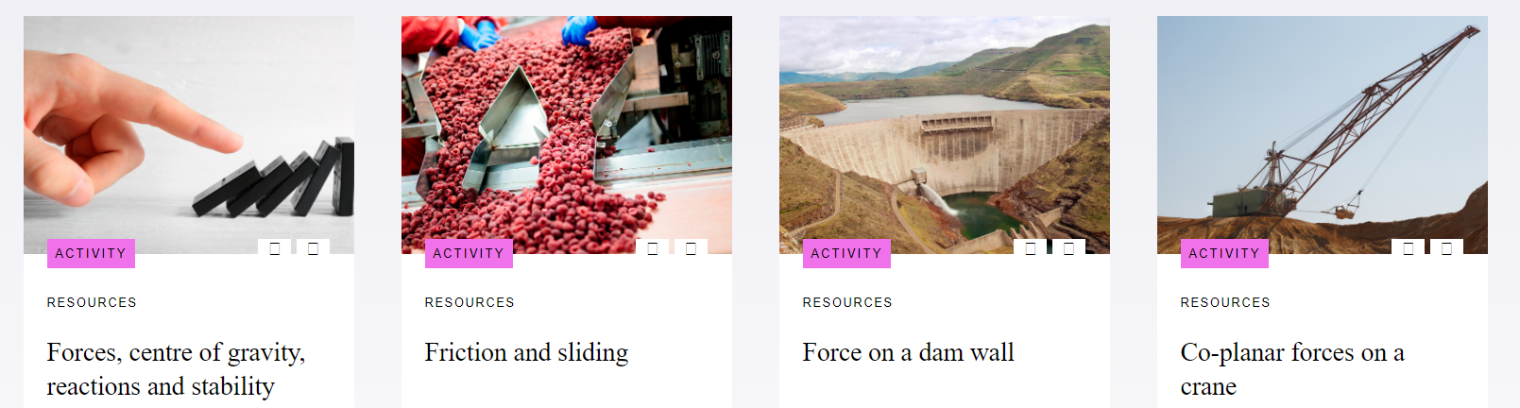
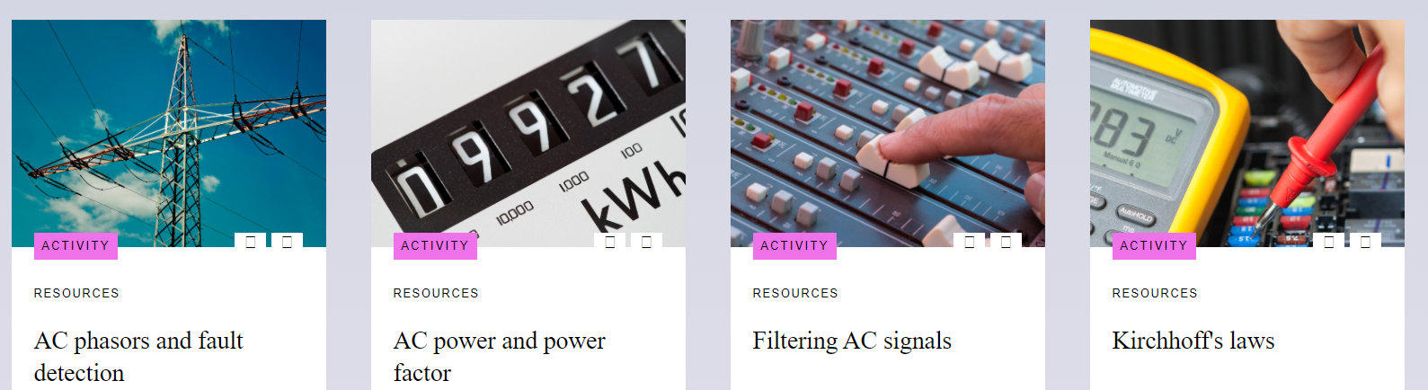
Existing Materials
Series of contextualised, interactive engineering resources for L3 technical courses.
Range of topics around mechanical and electrical concepts
STEMResources.raeng.org.uk/resources/post-16/

Slide 3
New Level 3 engineering resources
CNC Machining
Engineering Materials
Battery technologies
Microcontroller systems / PLCs
Advanced /emerging technologies
AR / VR
AI, Cybersecurity
Cyber-Physical systems, IoT
Robotics
Electrical machines
Renewable energy
Sustainability
The Academy is developing a new suite of
Free-to-use resources to support students and practitioners with teaching and learning
The resources will include short videos, interactive simulations, teaching materials, embedded careers information, etc.
The content will be independent of specific qualifications – so can be used for existing technical quals and new T levels
Current support areas will include:

Slide 4
New Enterprise support resources
Engineering design
- design for manufacture
- design for circular economy
Specifying problems
Generating ideas / Innovation
Capturing value
Working in start ups / SMEs
Growing and scaling a business
Intellectual property and copyright
The Academy’s Enterprise Hub supports start up’s and SMEs to grow their business
As part of a new programme to support technicians in start up’s and SMEs, we are developing new innovation and enterprise resources for FE colleges
Resources can be embedded in business modules, finance and engineering design
Topics will include:

Slide 5
Industry Placements support
To support the new T level industry placements, the Academy is developing a suite of ‘off the shelf’ engineering projects and frameworks for engineering businesses to provide to students
Projects will cover a range of sectors: automotive, aerospace, rail, energy, manufacturing
The framework will be flexible to enable businesses to put their own projects into the placement work
The framework will also be designed to be flexible around different placement approaches (day release, week placements, end of course placements)
The frameworks will also support businesses and practitioners to assess student performance

Slide 6
Your help!
To maximise the use and effectiveness of these resources, we need to hear from you.
We will establish steering groups for resource development and placement projects
All support is welcome!

Slide 7
Thank you.
Education@raeng.org.uk
Stylli.Charalampous@raeng.org.uk
Theofanis.Lampousis@raeng.org.uk
Lynda.Mann@Raeng.org.uk

