Slide 1
Engineering and Manufacturing
NFEC Update 19.11.21

Slide 2
Agenda
Engineering & Manufacturing Composition/ Pathways
GLH/ Funding bands
Core units/ example timetable
Engagement to date
Provider support
Next steps

Slide 3
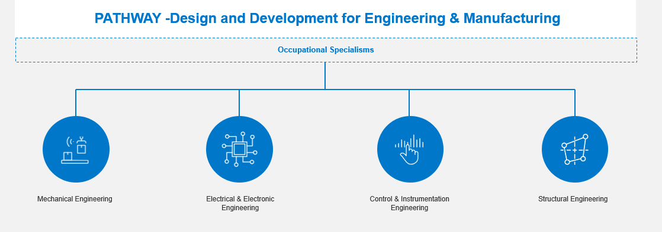
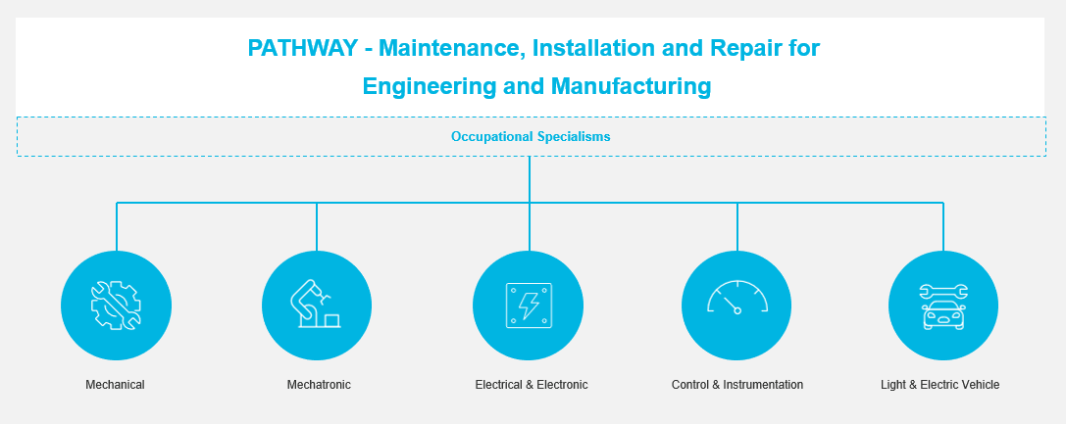
Route: Engineering and Manufacturing

Slide 4
Route: Engineering and Manufacturing

Slide 5
Guided Learning Hours/ Funding Bands
Engineering and Manufacturing |  | On Site Standards (Inc. Level) |  | Duration/ Mandatory on programme Qualification
Design and Development |  | Maintenance, Installation and Repair |  | Manufacturing, Processing and Control
Core Content (GLH) | Occupational Specialism (GLH) | Core Content (GLH) | Occupational Specialism (GLH) | Core Content (GLH) | Occupational Specialism (GLH)
680 | 680 | 680 | 680 | 680 | 680
1360 |  | 1360 |  | 1360
E&M – D&D, MPC and MIR TQs:
These TQs will fall into band 8 large T Level @£11,168 which requires delivery hours to be planned on average at 1510Hrs.
1510Hrs / 2 = 755Hrs per year
755Hrs / 36 weeks delivery = Average 21 hrs per week delivery excluding any Maths and English**.
Additional hours funding:
315 hours – Industry placement
150 hours – Employability, enrichment and pastoral hours
**Maths & English a single £750 payment per subject over 2 years if applicable (current funding amount)

Slide 6
Core Content Examination
Paper 1 – Maths and Science Principles for Engineering (6 Elements) (2hrs 30mins)
Paper 2 – Engineering in Context
(11 Elements) (2hrs 30mins)
ESP- Employer Set Project
17 Elements in total to make up the core
 | Element – Paper 1 | GLH
4 | Essential mathematics for engineering and manufacturing | 90
5 | Essential science for engineering and manufacturing | 90
6 | Materials and their properties | 60
7 | Mechanical principles | 35
8 | Electrical and electronic principles | 35
9 | Mechatronics | 30
 | Element – Paper 2 | GLH
1 | Working within the engineering and manufacturing sectors | 30​
2 | Engineering and manufacturing past, present, and future | 30​
3 | Engineering representations | 40​
10 | Engineering and manufacturing control systems | 30​
11 | Quality management | 30​
12 | Health and safety principles and coverage | 60​
13 | Business, commercial and financial awareness | 30​
14 | Professional responsibilities, attitudes, and behaviours | 15​
15 | Stock and asset management | 15​
16 | Continuous improvement | 30​
17 | Project and programme management | 30​
Assessment | Overall contribution
Core examination 1 | 35%
Core examination 2 | 35%
Employer-set project | 30%

Slide 8
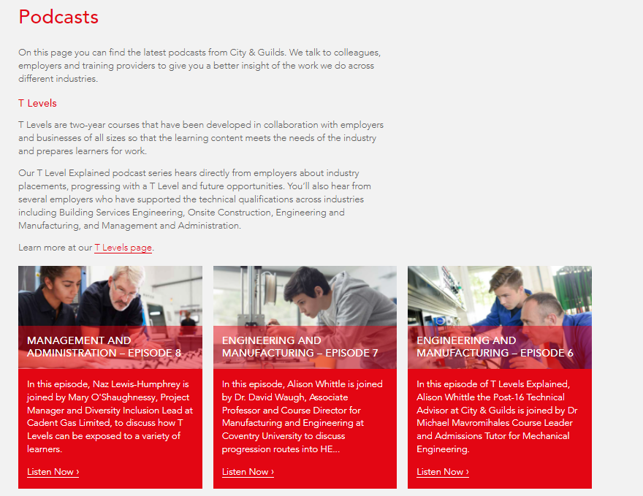
Engagement so far
Working with over 80 employers across the T levels
Regular HEI events
Regular PEI engagement
Provider engagement
Total of 95 providers engaged
Regular UTC events
Delivering to regional networks such as Greater Manchester Combined Authority, West Midlands Combined Authority and North East Region LEP
Two webinars already delivered on TQ content and Assessment methods. Recording available https://www.gotostage.com/channel/e3299ae88d8c4804a7e673c0aa5b0f35
Contact details for Technical Advisor – Samantha.ashman@cityandguilds.com

Slide 9
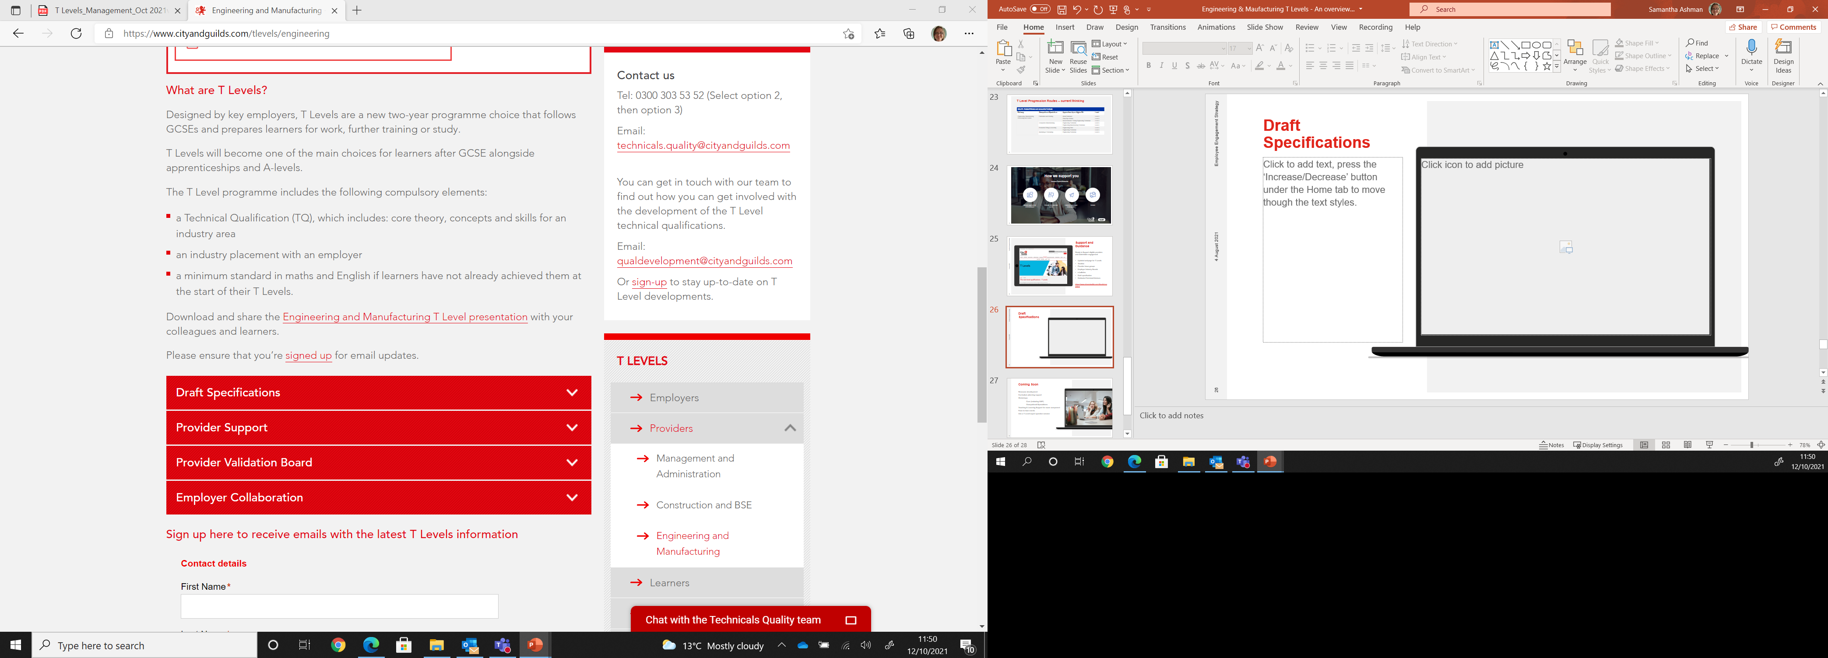
Next Steps
GSEM’s
Moving from Development to Live assessments
Webinars planned in throughout the year
Resources
Draft specs
Engineering and Manufacturing: Design and Development Technical Qualification Specification
Engineering and Manufacturing: Maintenance, Installation and Repair Technical Qualification Specification
Engineering and Manufacturing: Manufacturing, Processing and Control Technical Qualification Specification

Slide 10
T Level Associate Vacancies
There are a variety of contracted associate roles you may wish to apply as part of the T Level Qualifications such as-
Moderators/ Principal Moderators
Technical Qualification Associates (TQA’s)
Examiners and Assured Consultants
For further information please can Robert.stott@cityandguilds.com or visit our website on the attached link- Associate Vacancies | City & Guilds Group Careers

Slide 11
Questions? Thank you for attending
‘T LEVELS’ is a registered trademark of the Department for Education.
‘T Level’ is a registered trademark of the Institute for Apprenticeships
and Technical Education.

