Slide 1
AI and The Practitioner
Chair AI Group IST
Lead Global AI Accreditation
Dr Marie Oldfield
CStat, CSci, APAI, SFHEA FIScT

Slide 2
AI Confidence in the Workplace
Introduction
Examining where you are now
Where would you like to be
What barriers prevent this
How can you move forwards
Questions

Slide 3
Challenges for Educators and the Lay Person
Understanding the AI Landscape
Understanding how AI is used
Being aware of risk
Being Involved in the conversation
Being able to challenge where necessary

Slide 4
What do I need to know?
What is an AI Practitioner
What is a model

Slide 5
Value Subject Matter experts bring
AI Practitioners are subject matter experts and so should be involved in the entire life cycle of systems/models/algorithms that affect society
For this they need to understand the AI, the ecosystem and how it operates.

Slide 6
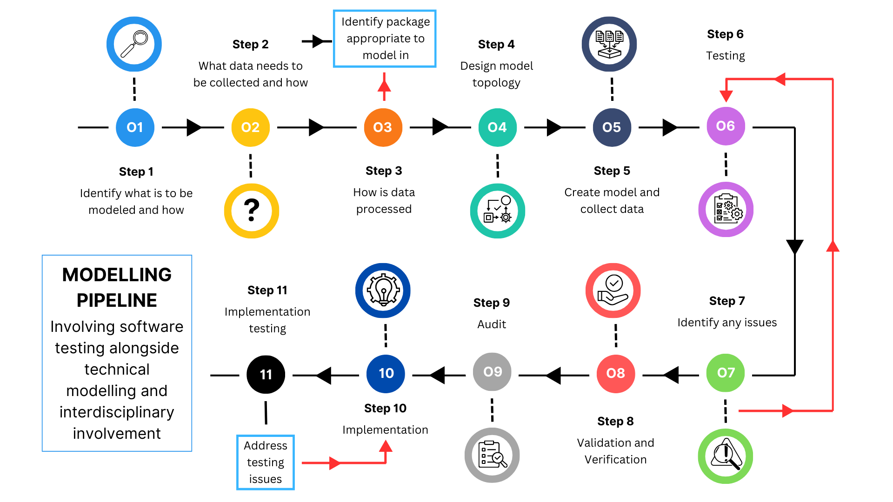

Slide 8
Communication Gaps
We need the opportunity to be able to discuss AI with technical and non technical people
This means we have to reduce the language barriers in a technically complex area.

Slide 9
Use cases
Data Analysis and interpretation across:
Defence
Financial
Health
Government

Slide 10
Use cases
Recruitment
Services
Banking
Etc etc
Could you be involved in this or just impacted by it?

Slide 11
Accountability and Liability
Upcoming Regulation
Upcoming Legislation
Existing Court cases
Is my involvement inevitable = Yes
Do I have value = Yes
Do I have a right and a requirement to be involved = Yes
Is there already a community involved in this = Yes

Slide 12
Accountability and Liability
For more managerial positions or higher level professional accreditation this is not only critical but will become necessary under the UK Governments plans for AI in the next decade. Where new systems are coming into the workplace Technicians should have enough knowledge to be able to query the systems and satisfy themselves that they are happy with the systems.

Slide 13
Education Project
Communication
Knowledge
Risk Awareness
Individual Liability
Individual Accountability

Slide 14
Why Register
Professional Accreditation & Standards ratified by industry, academic and government partners

Slide 15
Why Register
Gain recognition for your achievements.
Join a community of like-minded professionals
Demonstrate your competence and skills.
Commit to the maintenance of high and exacting standards.
Substantiate your integrity, ethics and commitment to reducing harm to society.
Hold yourself accountable to your peers and promote professional standards in your industry.
Demonstrate a commitment to continuing professional development.

Slide 16
What’s in it for me
Feel more confident in your role and professional competence.
Demonstrate to businesses, employers, peers and organisations your professional competence.
Fulfil your employer and industry requirements through demonstration of professional development.

Slide 17
What’s in it for me
Identify areas for improvement and increase your skills. Demonstrate progression by advancement through
levels of registration.
Increase your earning potential and opportunity for employment.
Gain a sense of achievement and professional satisfaction.
Join a community of like-minded professionals

Slide 18
Benefits for Employers
Reduce risk and liabilities.

Slide 19
How can the IST help?
AI Group
Seminars
AI Training Courses
AI Registration and Professional Accreditation
Mentor Schemes
Networking Events
Conferences

Slide 20
Start your Professional Journey now
It’s FREE for Students!
Fill in the forms we have here today
Contact Us: office@istonline.org.uk
Web: istonline.org.uk

Slide 21
Contact Us: office@istonline.org.uk Web: istonline.org.uk

